Slide 1
Results pertaining to Gf and GO skill reported in Hambrick & Hoffman’s (2016) IEEE Intelligent Systems article

Slide 2
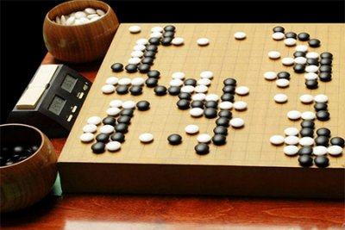
Reanalyses of results from GO study by Masunaga (née Takagi); correlations obtained from Takagi (1997) and Masunaga and Horn (2002, Psychology & Aging).

Slide 3
SEM reanalysis: Strong effect of Gf on GO skill (.63), as measured by GO move-choice task
.24
Maze
.49
.31
BackSpan
.56
Gf
.38
Topology
.61
.85
.72
PowerLet
.67
.63
.66
-.12
.51
Recall
.71
-.15
GO Skill
.78
GO Rank
Gsm
.30
Recog
.55
.55
.22
.68
-.18
.01
.43
Speed-I
.65
-.13
Gs
.59
Speed-C
.77
Figure 5 from Hambrick et al. (2016), Psychology of Learning and Motivation

Slide 4
Correlations of Gf Indicators with GO Skill, by Skill Level
Skill Level
Gf indicator Beg. Inter. Exp. Pro
Maze .11 .21 .19 .23
BackSpan .16 .28** .17 .07
PowerLet .29* .47** .37** .37
Topology .28* .36** .32** .02
Avg. r .21 .33 .26 .17
Note. Beg., Beginner; Inter., Intermediate; Exp., Expert; Pro, Professional.
*p < .05; **p < .01
From Masunaga’s (née Takagi, 1997) dissertation, Table 34

Slide 5
Multiple-groups SEM with Gf predicting GO Skill, by skill level group
Beg. = .33, p < .05
Int. = .57, p < .001
Exp. = .43, p < .001
Gf
GO Skill
Constraining paths to be equal has negligible and non-significant impact on model fit, indicating that values are not significantly different from each other. Professional group n too small to include this group in the SEM.
From Masunaga’s (née Takagi, 1997) dissertation, Table 34

